Slide 1







ESS Data Management & Software Center
- en dansk del af ESS
Peter Willendrup
NEXMAP, DTU Fysik & ESS DMSC
With input from
Jon Taylor, ESS
Thomas Holm Rod, ESS
Ken Andersen, ESS
ESS Corporate Presentation | 2013

Slide 2
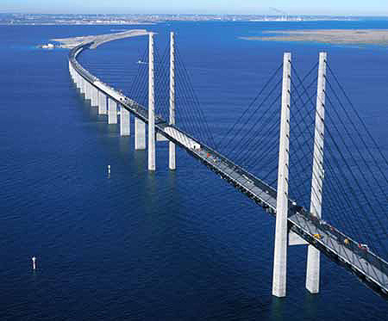
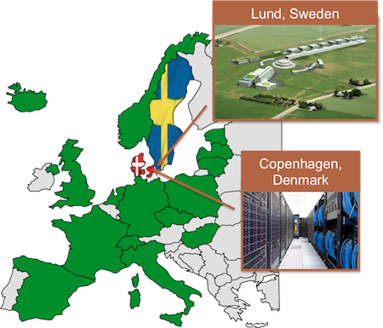
The Data Management and Software Centre
DMSC at DTU in Lyngby, Denmark
Data Management
Instrument Control
Data Reduction & Analysis
Instrument simulations
(Theory and simulations)
Built on DK competences!
Notes:
New picture

Slide 3
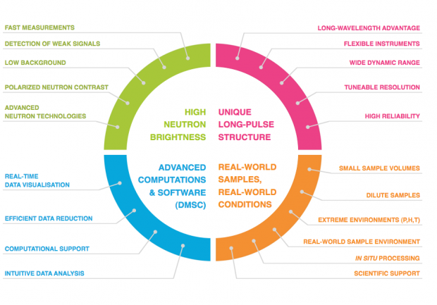
Technical Design Report (2013)
Importance of computing was emphasized already in design phase

Slide 4

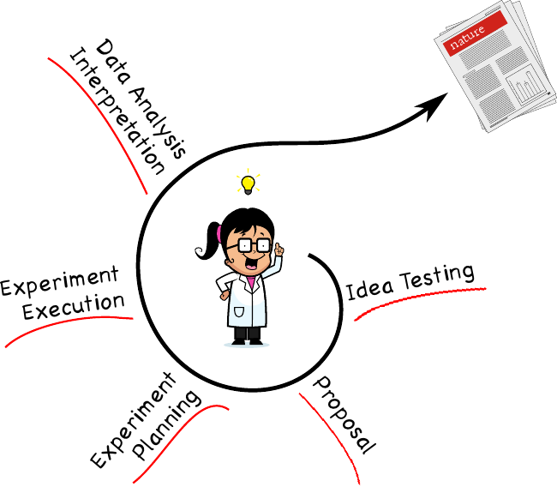
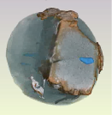
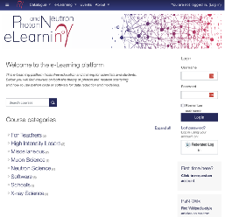
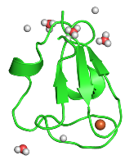
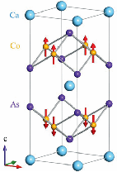
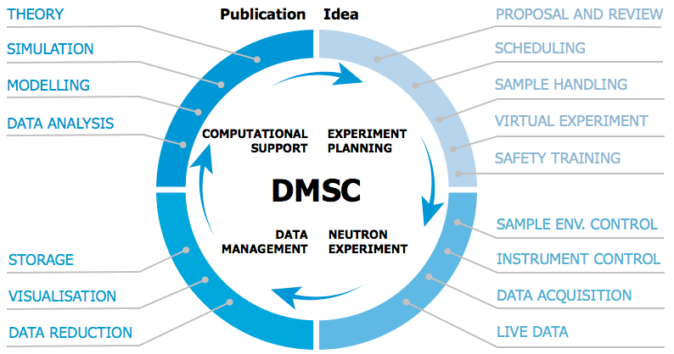
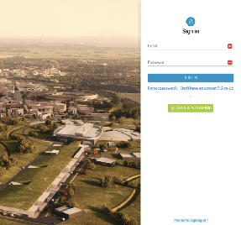
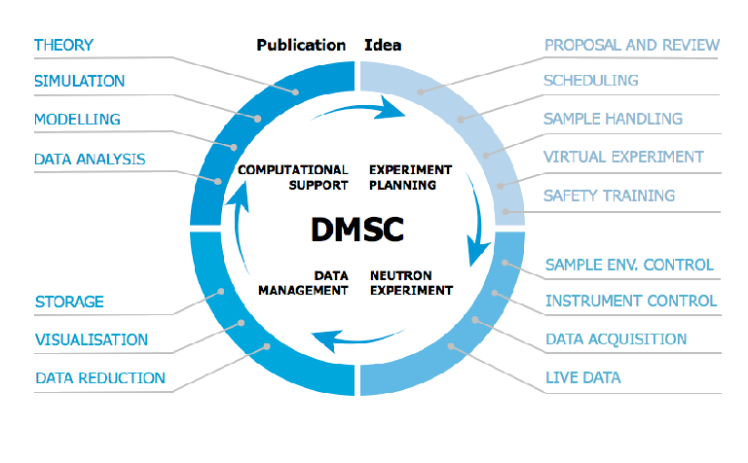
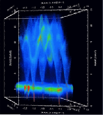
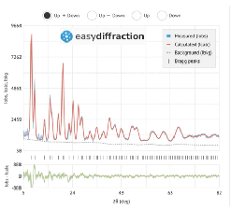
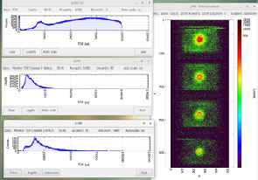
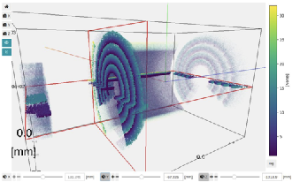
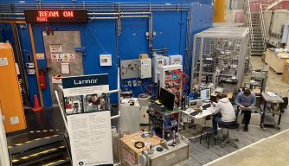
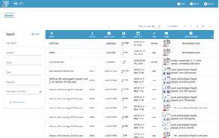
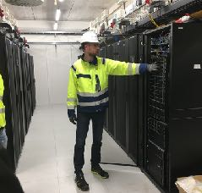
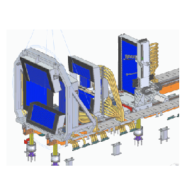
User journey
Support user from idea to publication with scientific computing tools & services
2024-09-24
PRESENTATION TITLE/FOOTER

Slide 5
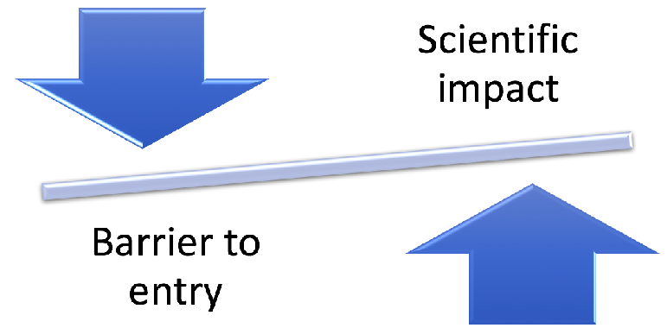
DMSC objective
Minimize the time it takes to analyze and interpret experimental data
Maximise the scientific impact and success of ESS by serving the needs of both non-expert and advanced users
This is particular important for neutron sources due to the cost of producing neutrons

Slide 6





The user community is diverse – even for each instrument
Non-expert and occasional user (few days/year)
Experienced (daily) or geeky user
Graphical User Interface
Command Line Interface
The Niels Bohr Institute
Notes:
Management and coordination is important

Slide 7
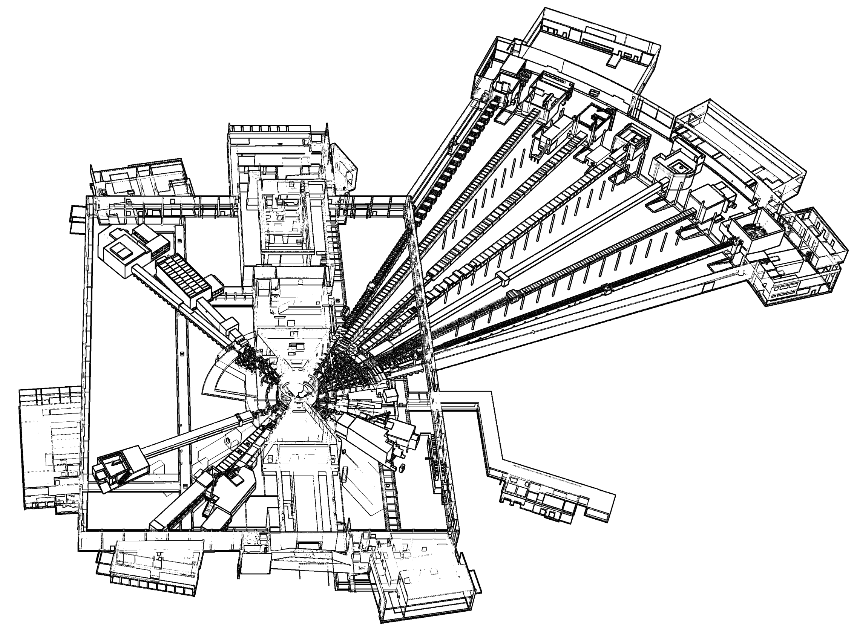










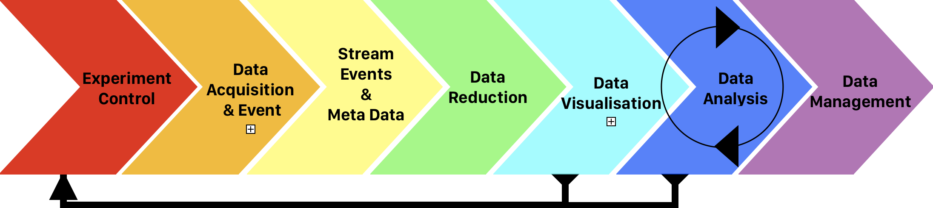
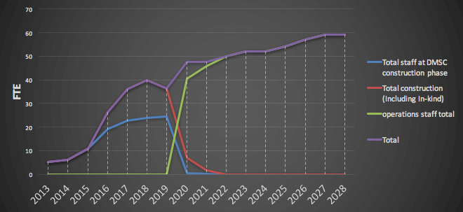
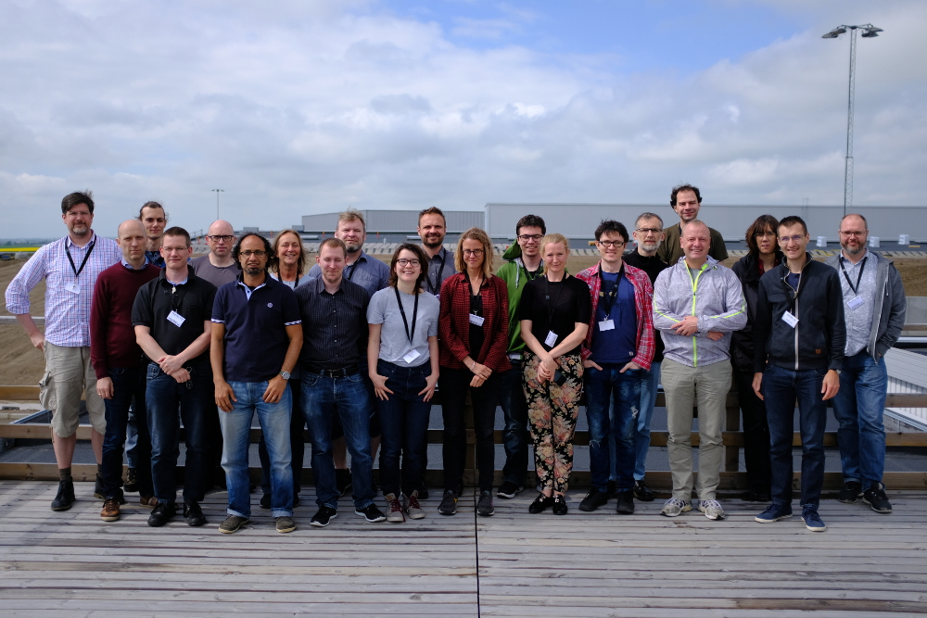

DMSC
Facility datarates:
~ TB / instrument / day
~ PB / instrument/ year
NMX
BEER
TO DO:
Scientific
computing
and software
for ALL of this
CSPEC
BIFROST
MIRACLES
MAGIC
ODIN
T-REX
HEIMDAL
DREAM
LoKI
VESPA
SKADI
FREIA
ESTIA

Slide 8
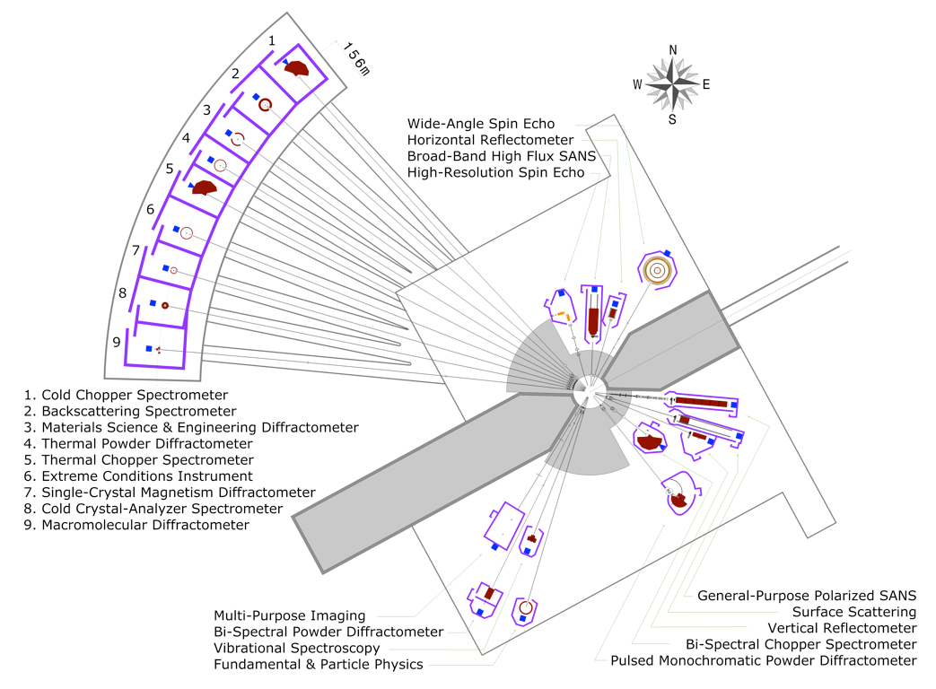
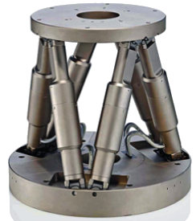
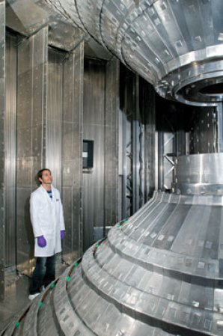
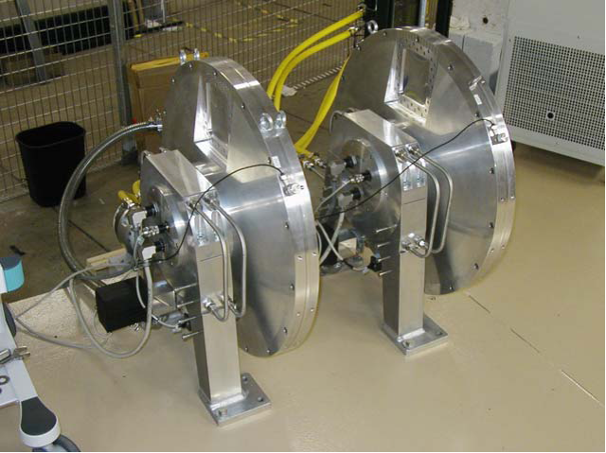
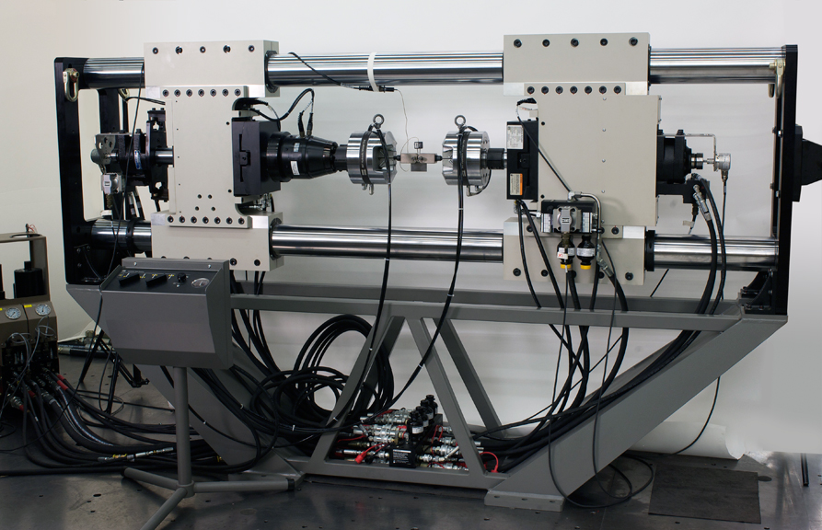
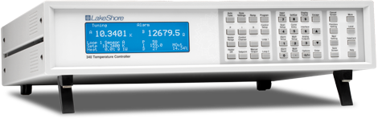
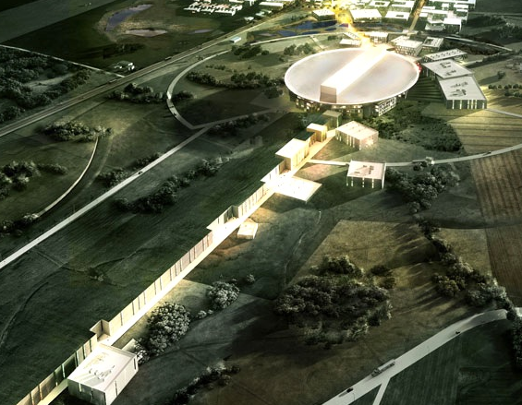
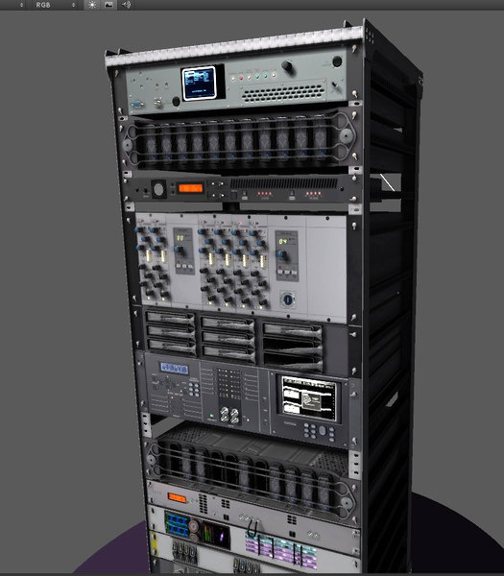
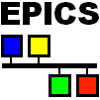
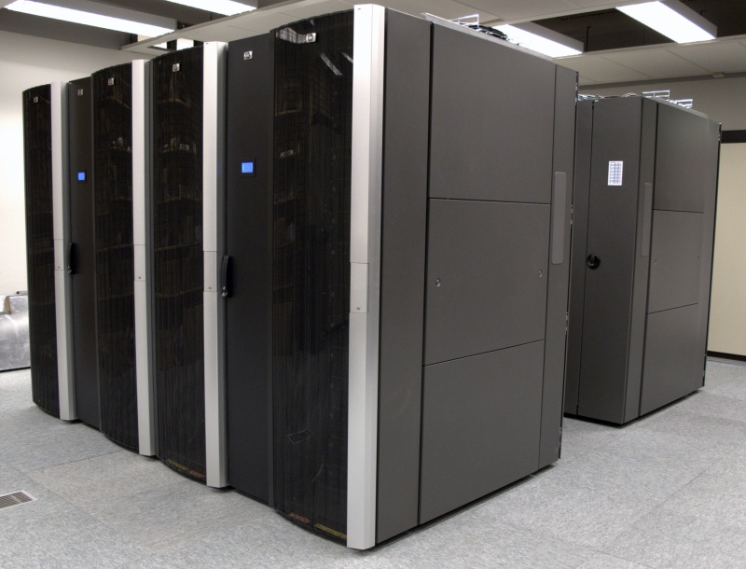


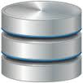

DMSC’s Domain and Interfaces
INSTRUMENT TECHNOLOGIES
Choppers
Motion Control
Sample Environment
Fast Sample
Environment
Detectors
& Monitors
Timing
Fast Data
Readout
DATA MANAGEMENT &
SOFTWARE CENTRE
INTEGRATED
CONTROL SYSTEMS
Control Box
Data Aggregator
& Streamer
User Control
Interface
Automated
Post Processing
Live, Local & Remote
Data Reduction
Data Analysis Interfaces
Instrument Control Room
ESS Server Room
DMSC Server Room

Slide 9
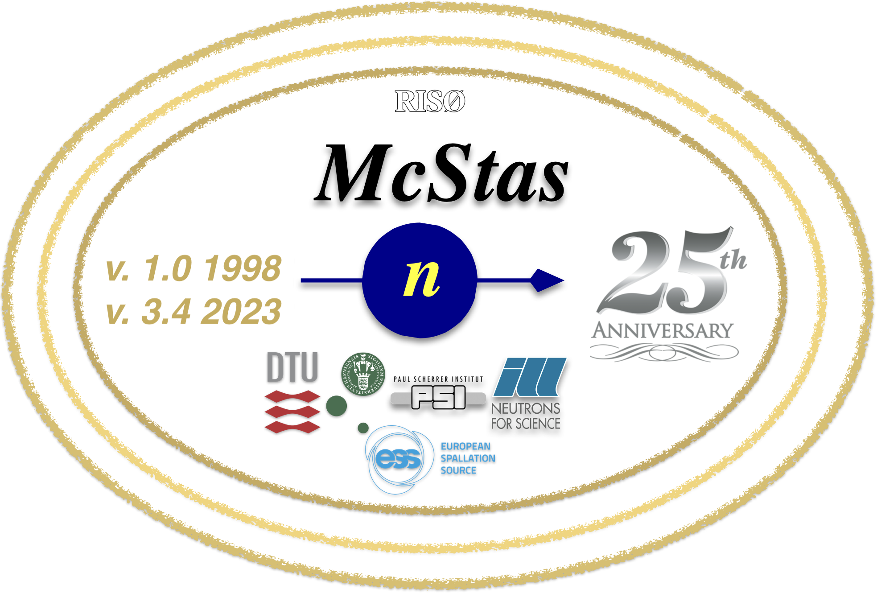
We must cater for many different scientific domains
 | Instr. |  | Tasks | Programs
 | ODIN | Im | Computed Tomaggrapy, ToF, diffraction imaging, polarization | MuhRec
 | BEER | Diffraction | 2D Rietveld Resolution func. Time-of-flight | FullProf Esmeralda Phenix
 | DREAM
 | HEIMDAL
 | MAGIC
 | NMX
 | LoKI | Large-scale | 2D Fitting Polarization Ab initio model | SASView CCP-SAS ?
 | SKADI
 | ESTIA
 | FREIA
 | C-SPEC | Spectroscopy | Resolution func. Spin dynamics Molecular dyn. DFT | MANTID VATES/HORACE SpinW LAMMPS VASP
 | VOR
 | T-REX
 | BIFROST
 | MIRACL
 | VESPA
(Incomplete list)

Slide 10

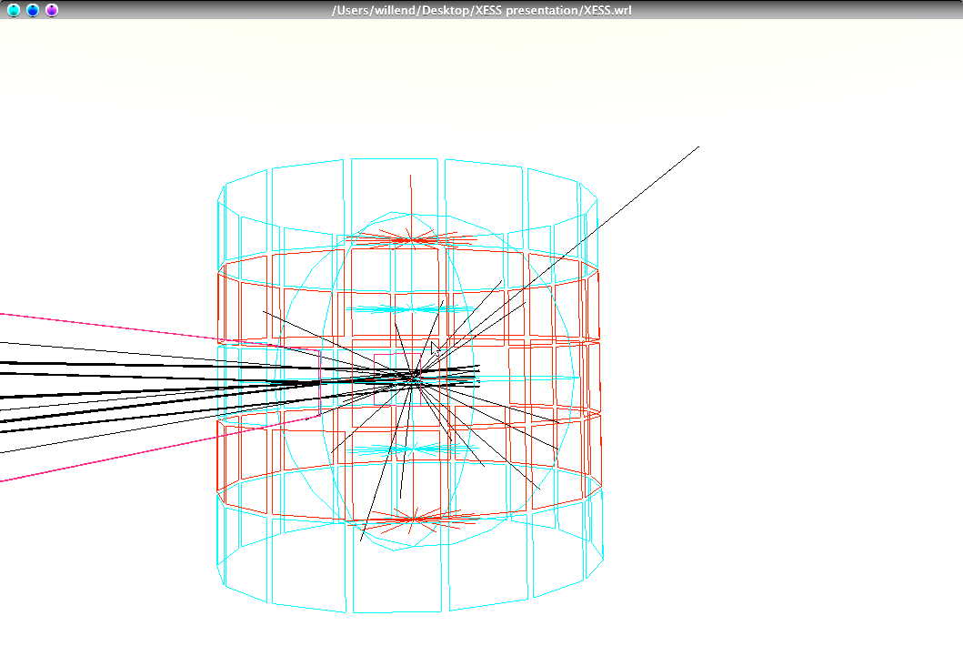
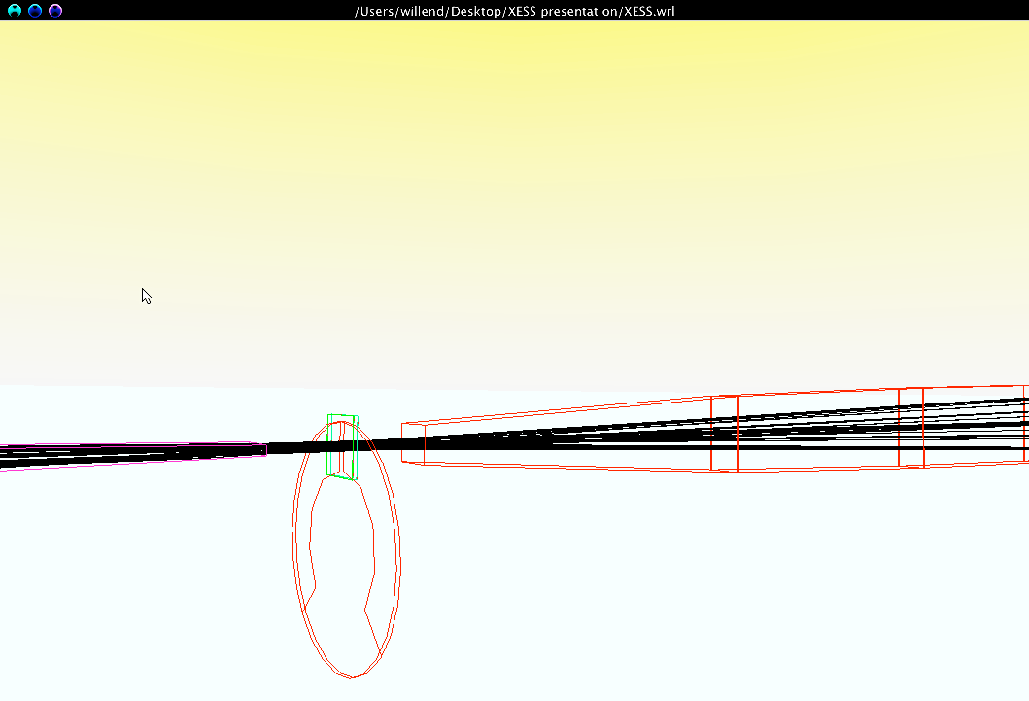
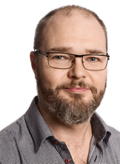
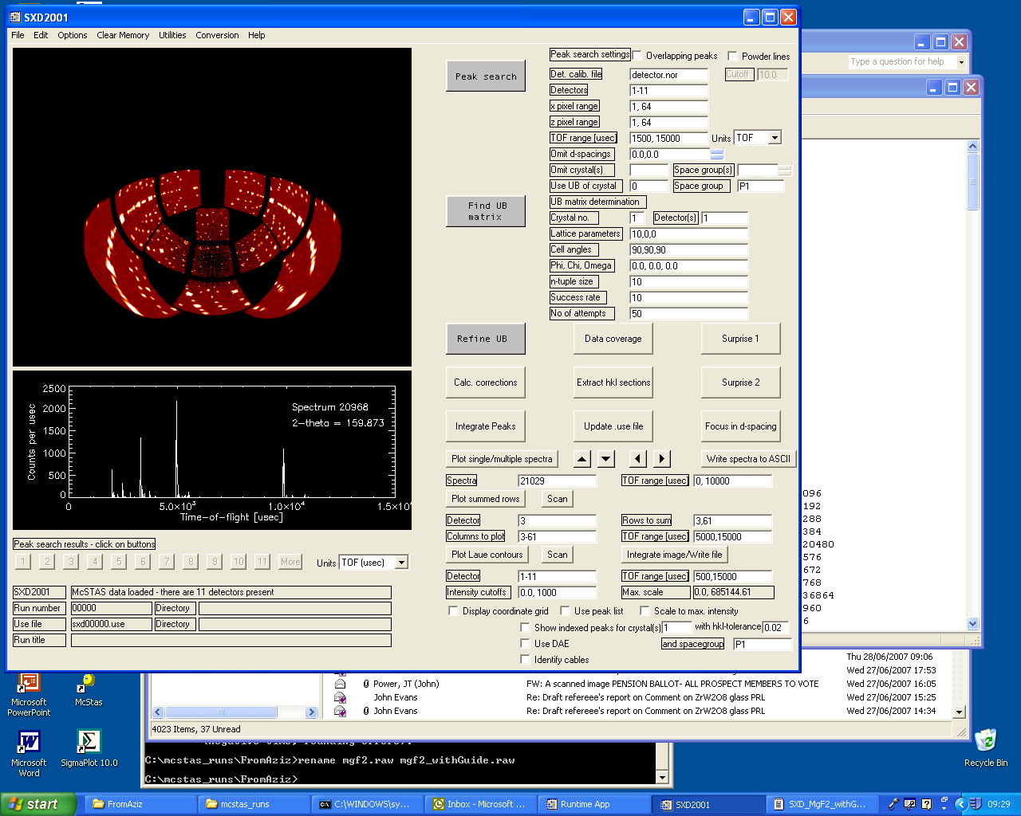
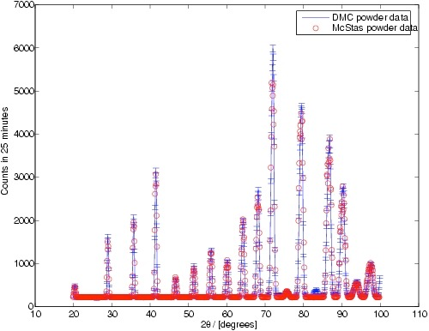
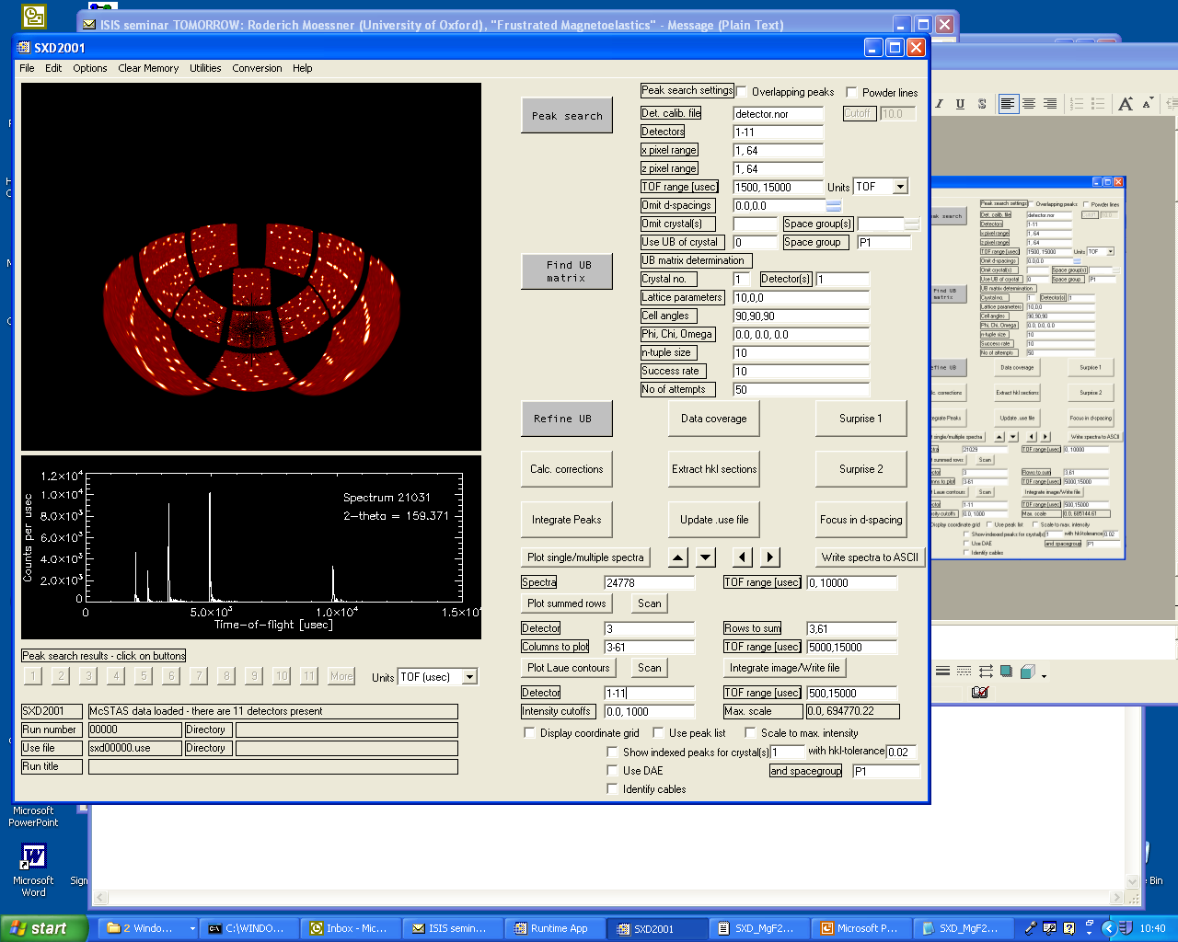
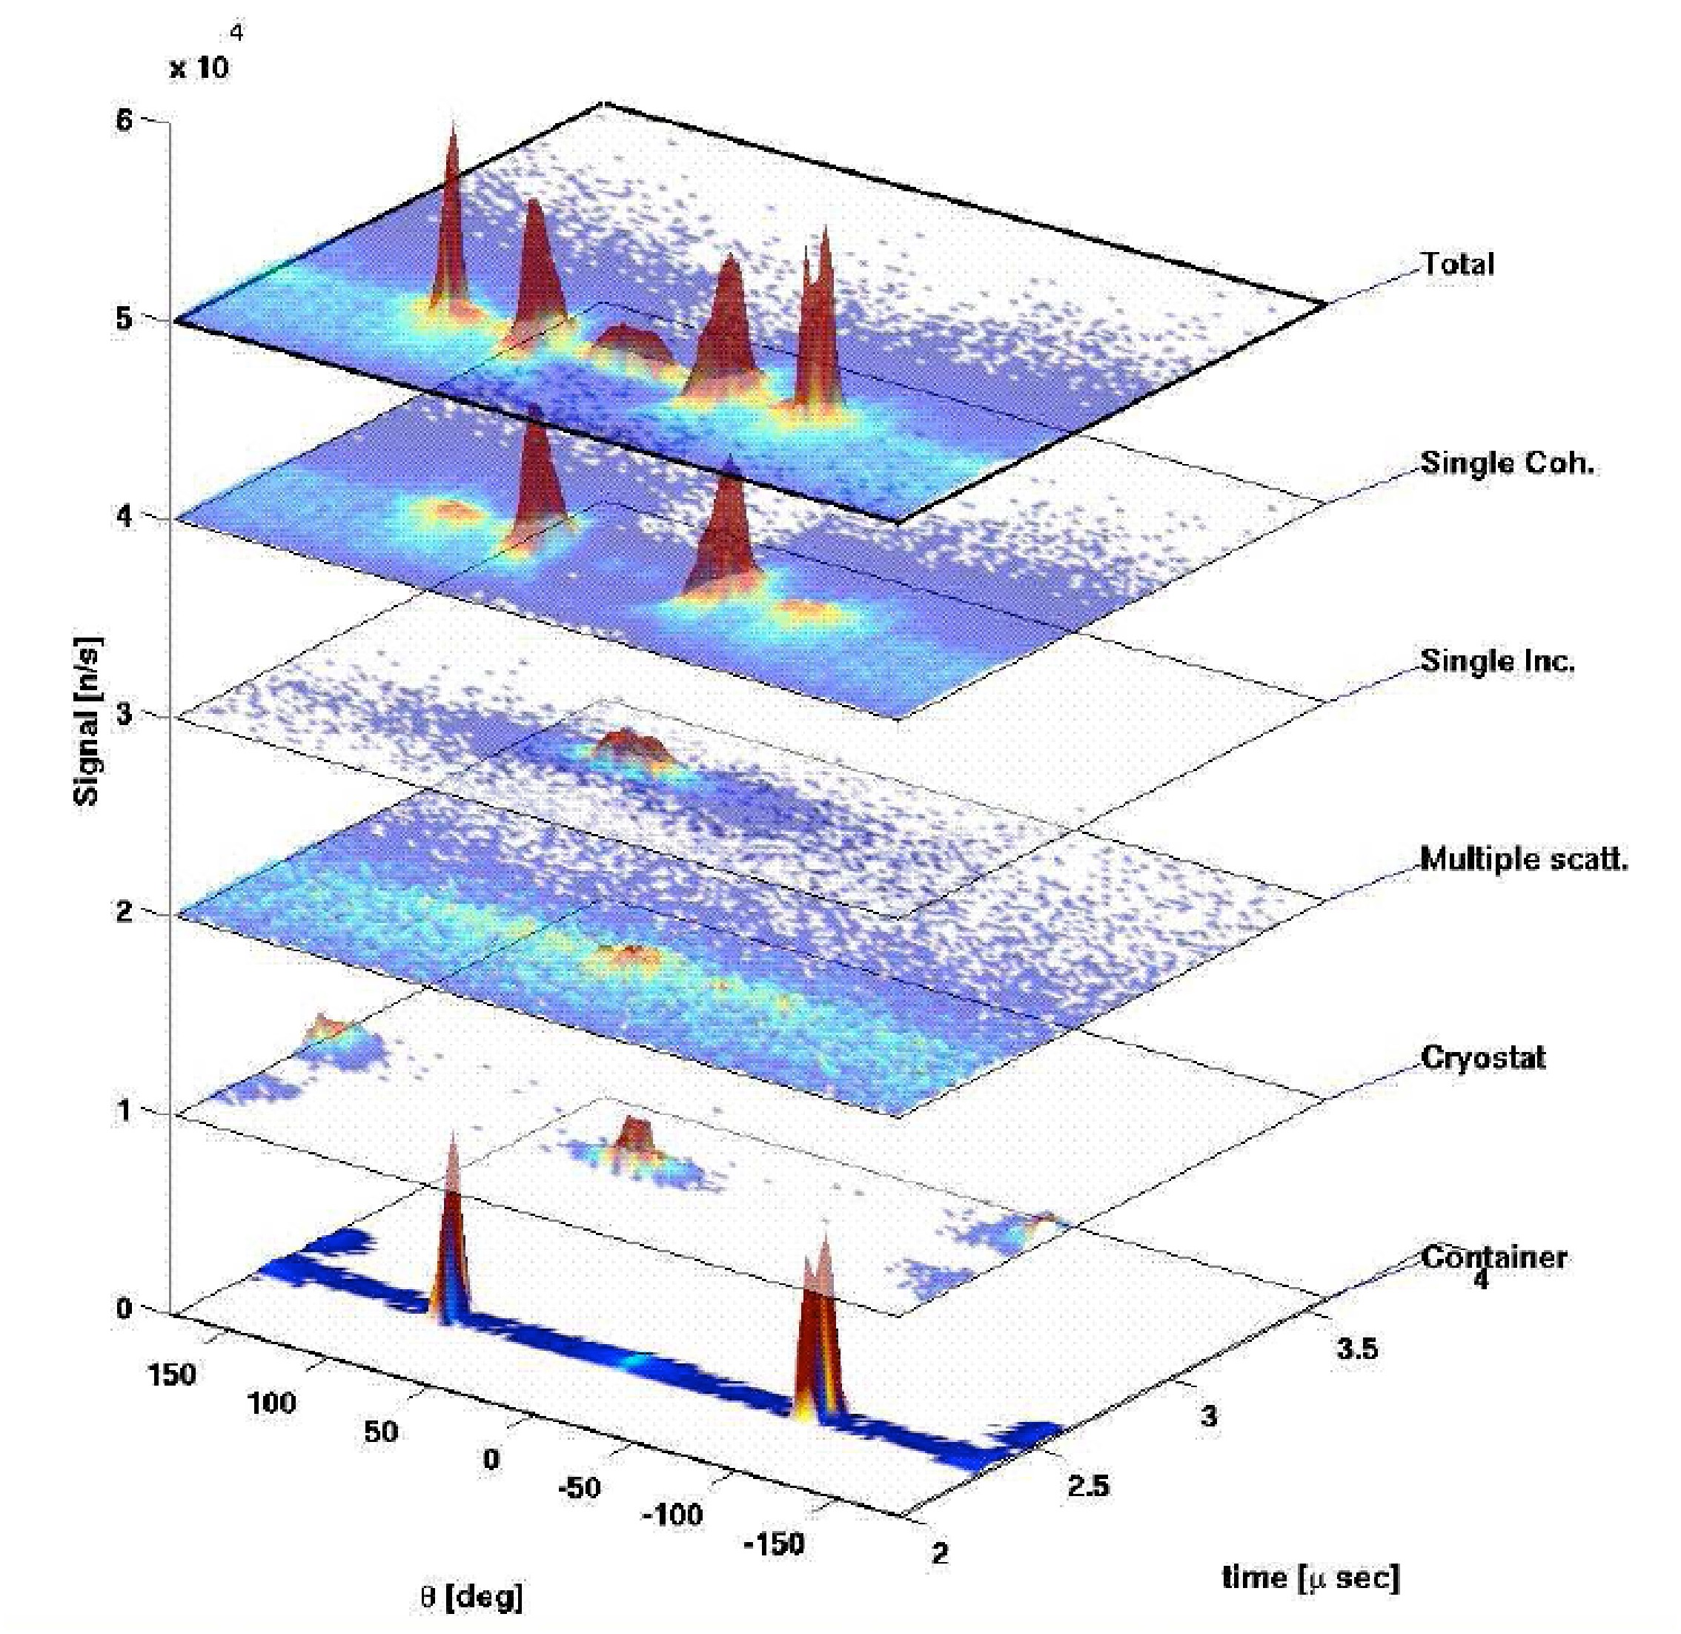
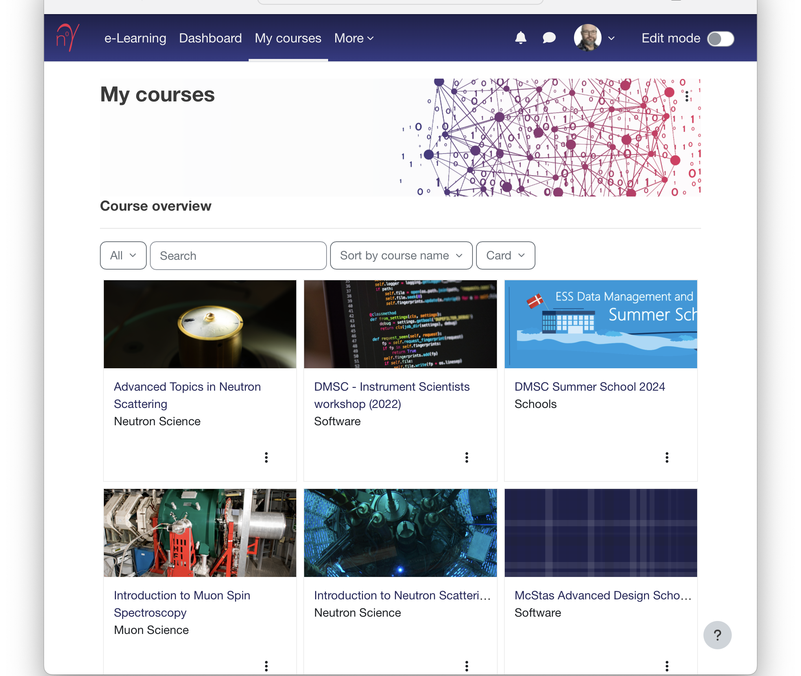
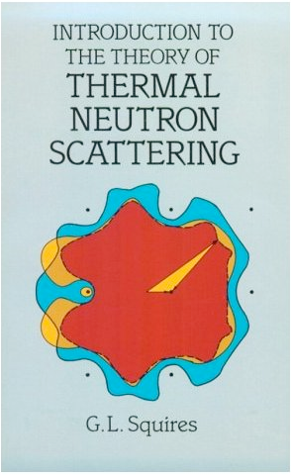
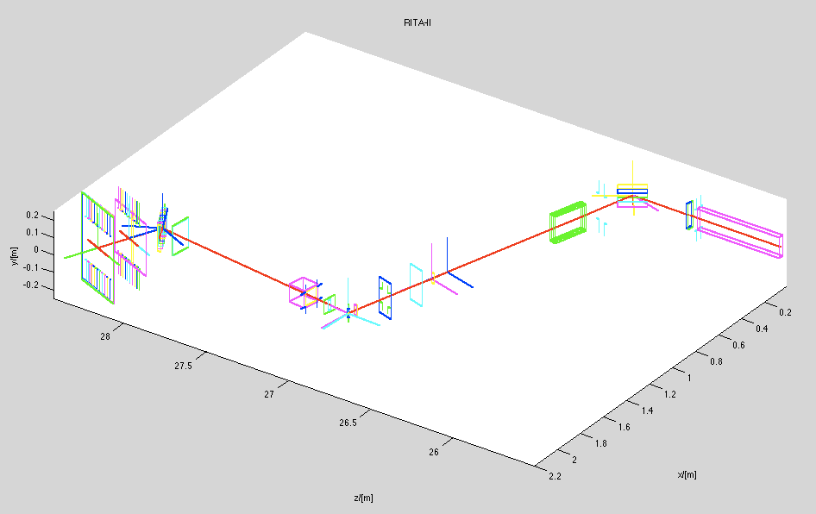
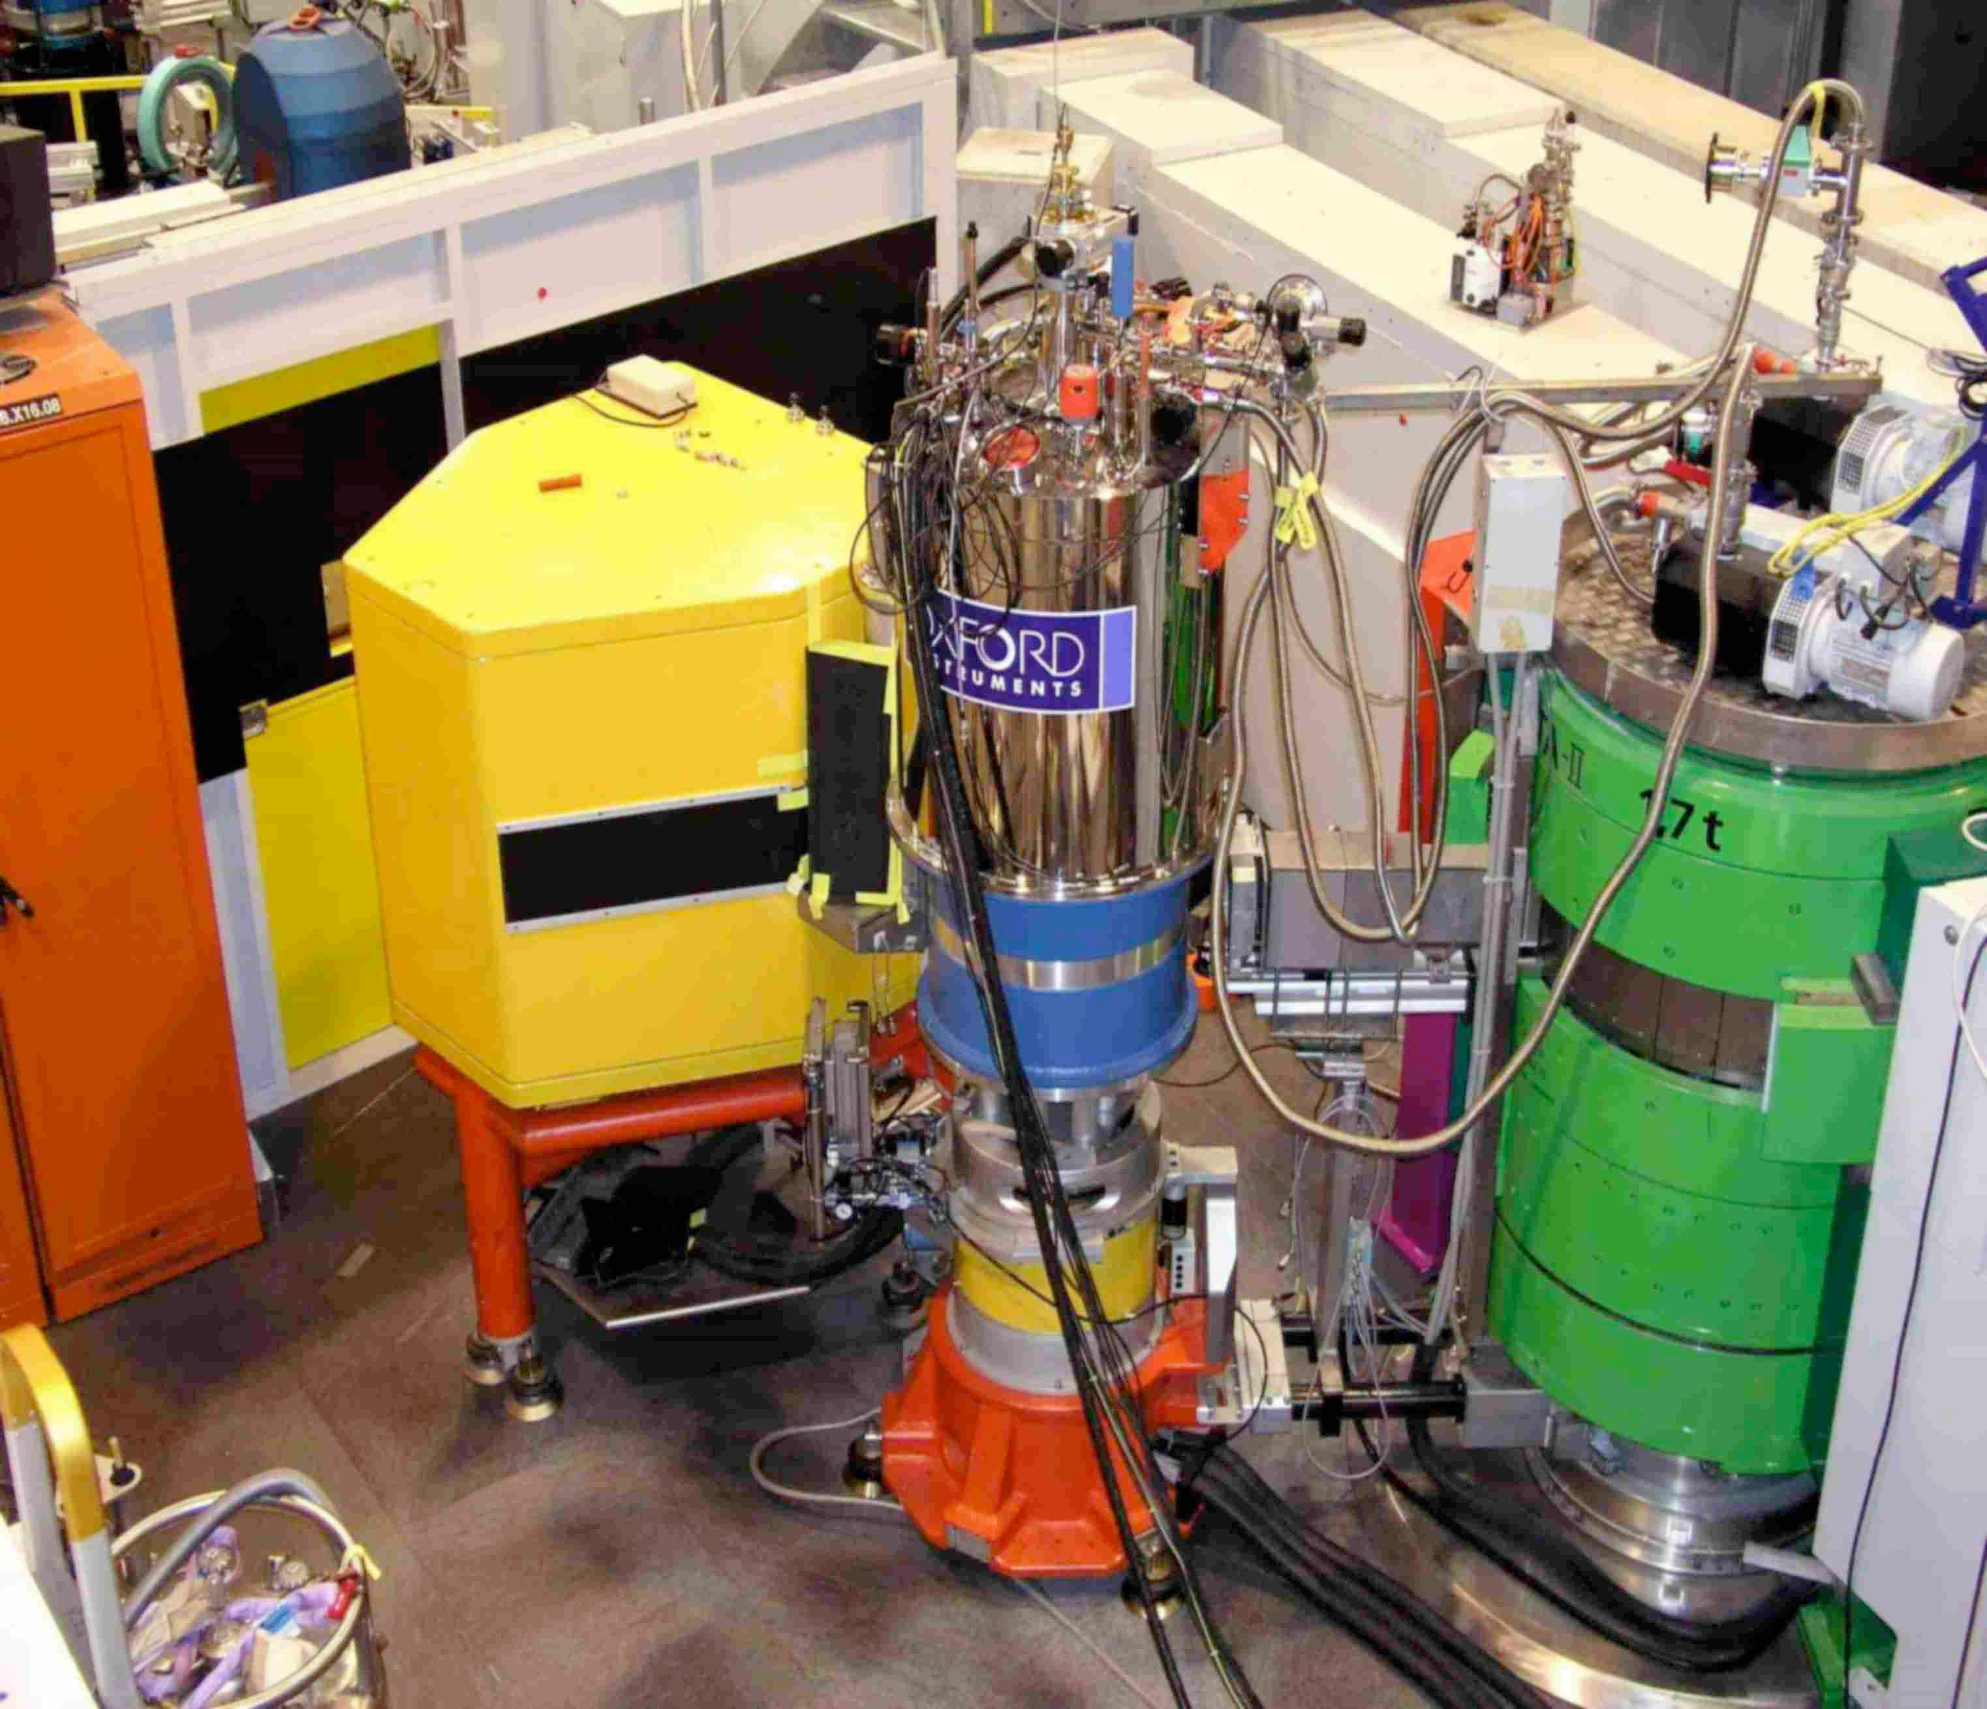


What is McStas used for?
Instrumentation
Virtual experiments
Data analysis
Teaching
(KU, DTU)
McStas and McXtrace: simulation tools for neutron- and X-ray instruments

Slide 11



Scientific computing gives understanding
Experiment
Reality
Modelling
An approximate representation of reality
A cartoon representation of reality

Slide 12
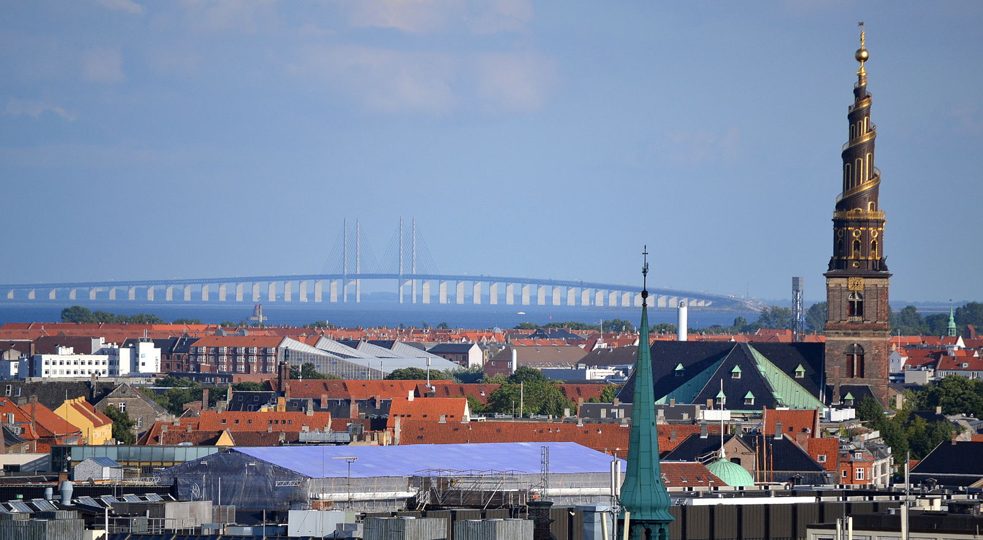
Questions
Notes:
Say something about data fusion, combining data

